Slide 1



Verifying Model Transformations for Real
Levi Lúcio
work done jointly with:
Bentley James Oakes, McGill University
Gehan Selim, Queen’s University
Cláudio Gomes, University of Antwerp
School of Computer Science, McGill University, Montreal, Canada
May 13, 2015

Slide 2
Outlook
Theory: properties of DSLTrans model transformations and their proof
Practice: implementing a fully automatic property prover
Case studies: proving properties of large transformations
Going mainstream: proving properties of ATL transformations

Slide 3
Problem Statement
We want to prove pre- / post- condition structural, properties (contracts) of a translation model transformation, for all its executions.
The infinite amount of transformation executions implies the proof needs to be done on a finite abstraction of the transformation’s executions.

Slide 4
Problem Statement
How can we build this abstraction mechanically and use it to prove properties?
Does the technique scale?
Can it be used in practice?

Slide 5
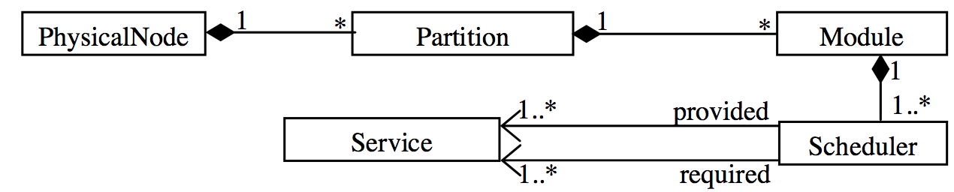
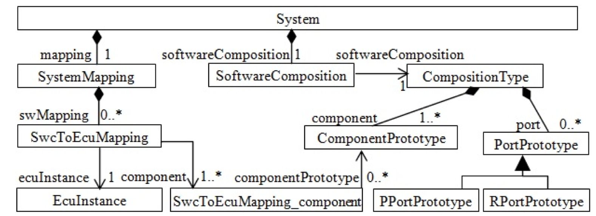
VCS to AUTOSAR Transformation [1]
VCS Metamodel (obfuscated fragment)
AUTOSAR Metamodel (fragment)
[1] G. Selim, S. Wang, J. R. Cordy, J. Dingel. “Model Transformations for Migrating Legacy Models:
An Industrial Case Study”. ECMFA 2012, Lyngby, Denmark (LNCS)

Slide 6
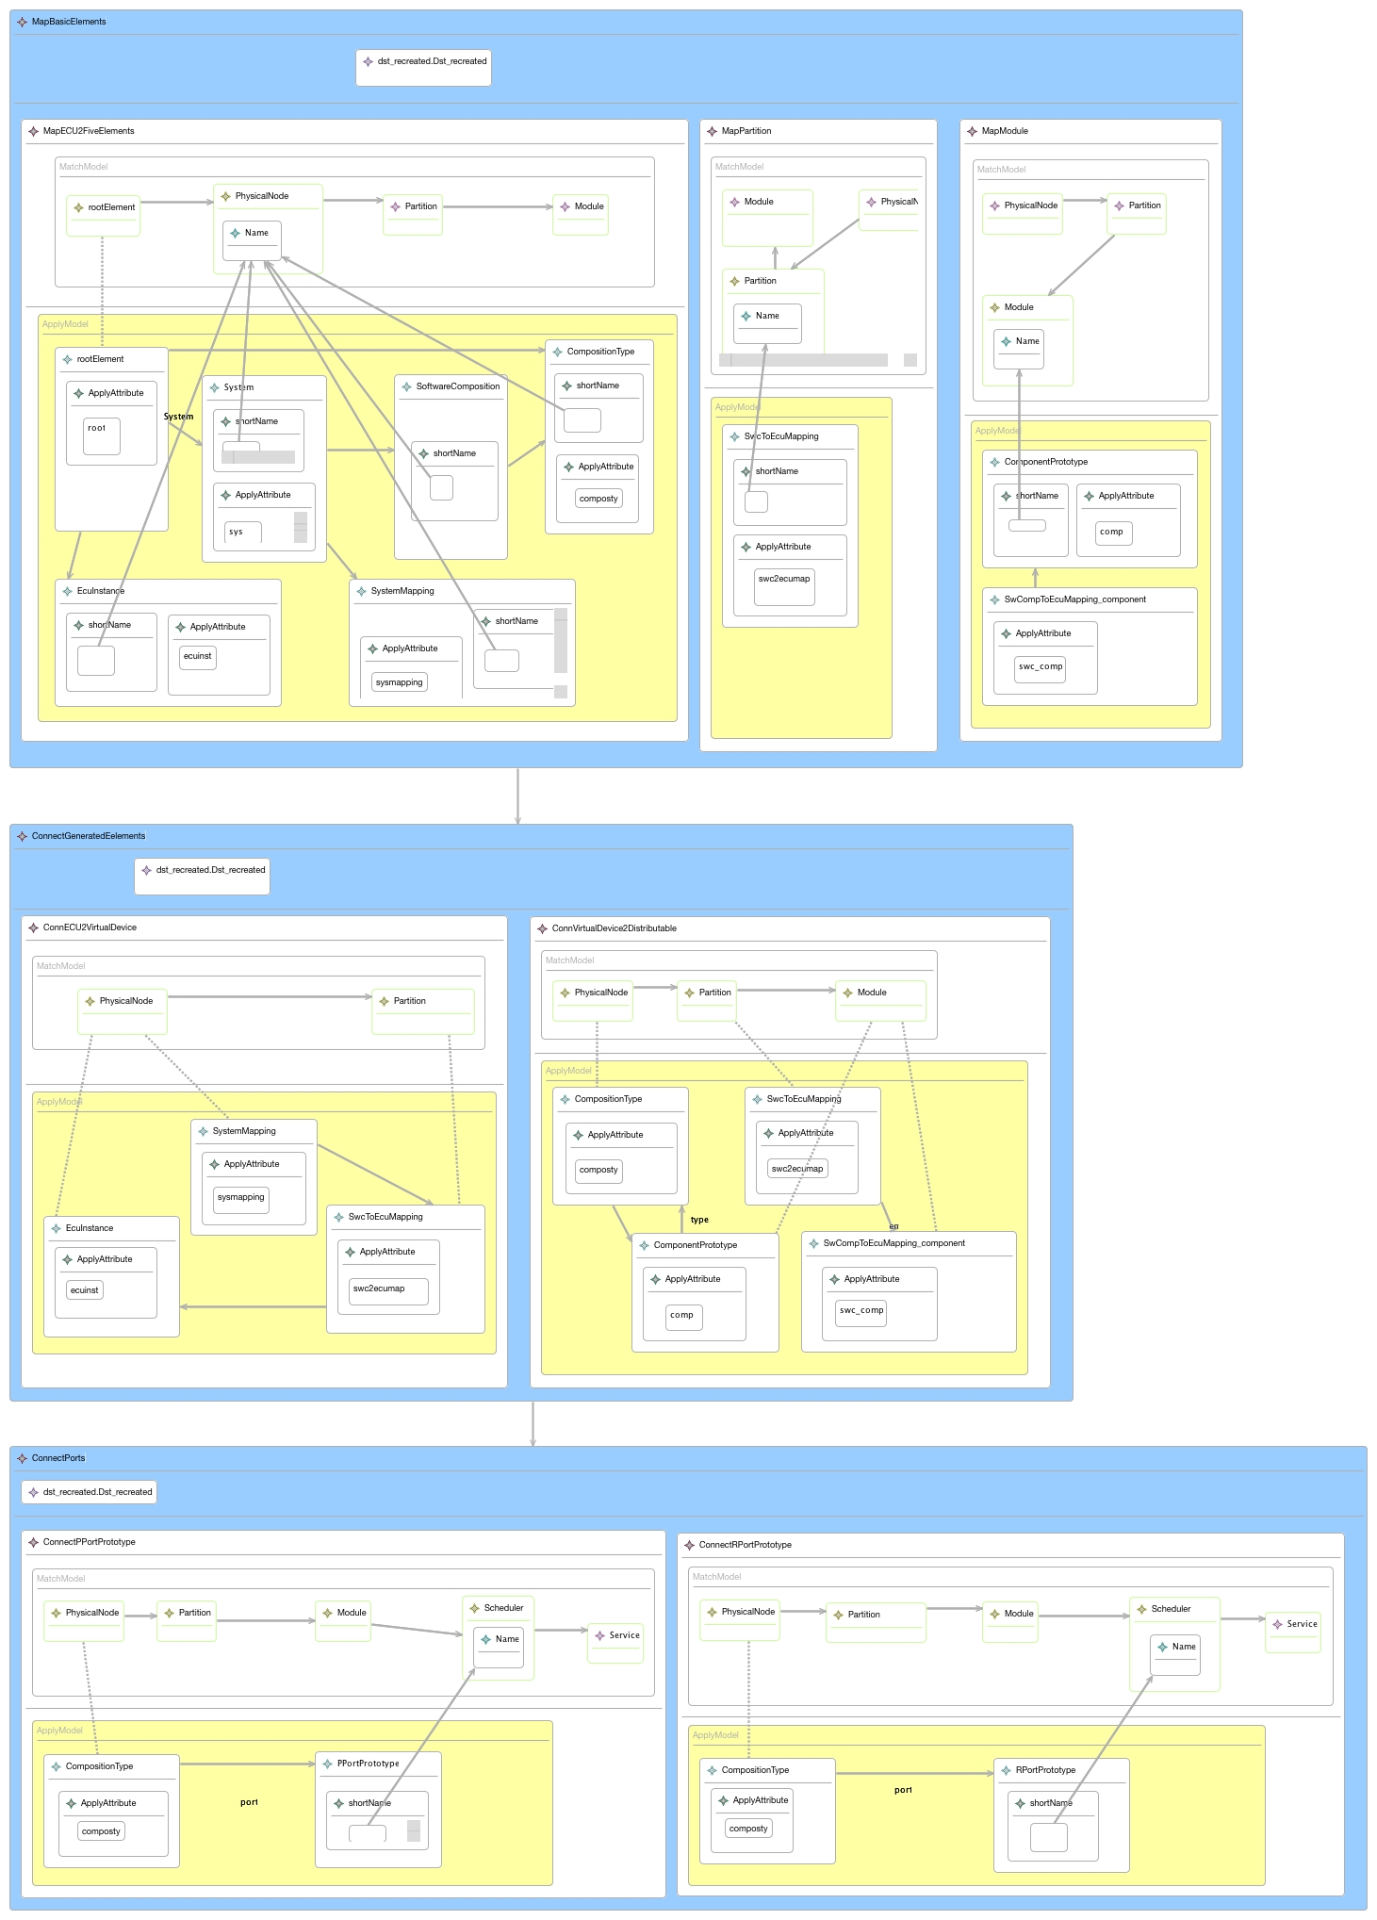
Migrating Legacy Models from VCS to AUTOSAR in DSLTrans [2]
Layer 1
Layer 2
Layer 3
[2] DSLTrans: A Turing Incomplete Transformation Language, B. Barroca, L. Lúcio, V. Amaral R. Félix, V. Sousa. Proceedings of SLE 2010, Eindhoven, Netherlands, 2010. (LNCS)
Notes:
DSLTrans is made only for translations
Termination and confluence by construction
Expressiveness Reduction
I will speak on more length about DSLTrans transformations on friday

Slide 7
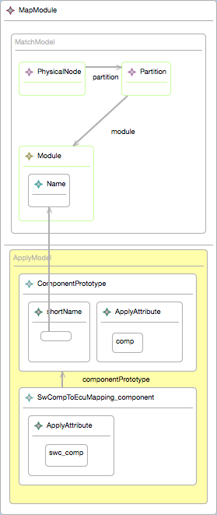
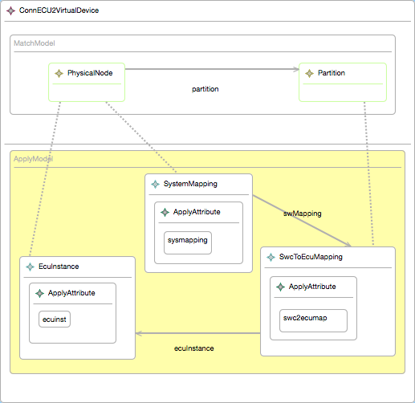
DSLTrans Rule Detail

Slide 8
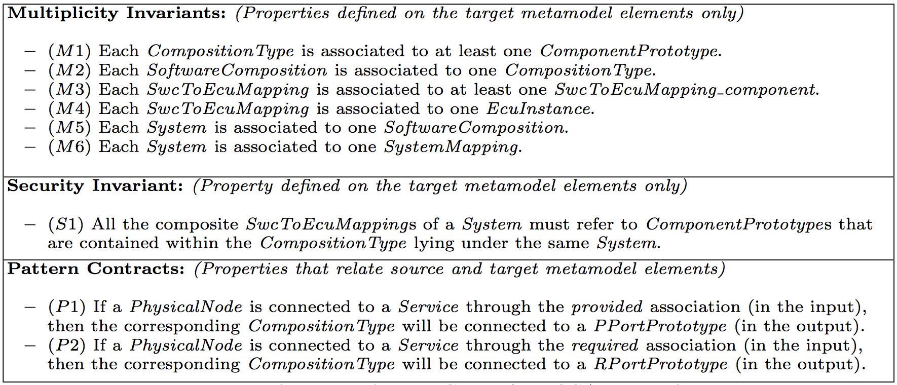
Requirements [3] for the migration transformation from General Motors
[3] G. Selim, S. Wang, J. R. Cordy, J. Dingel. “Model Transformations for Migrating Legacy Models:
An Industrial Case Study”. ECMFA 2012, Lyngby, Denmark (LNCS)
Notes:
Structural requirements, as done in the mathworks for flatenning transformations
Classes of properties

Slide 9
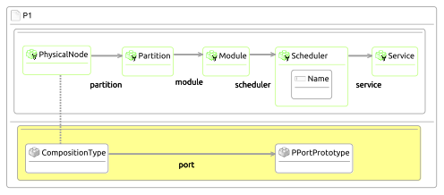
Example property [4]
P1: “If a PhysicalNode is connected to a Service through the provided association (in the input), then
the corresponding CompositionType will be connected to a PPortPrototype (in the output).”
[4] G. Selim, L. Lúcio, J. R. Cordy, J. Dingel and B. Oakes. ” Specification and Verification of Graph-Based Model
Transformation Properties” ICGT 2014, York, UK. (LNCS)

Slide 10
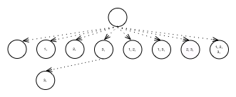
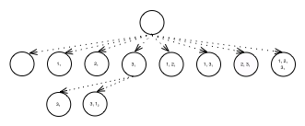
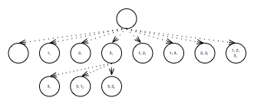
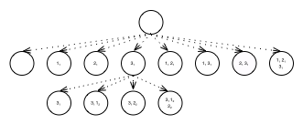
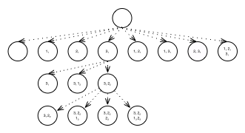
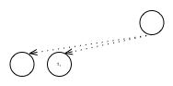
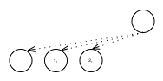
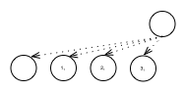
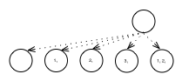
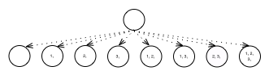
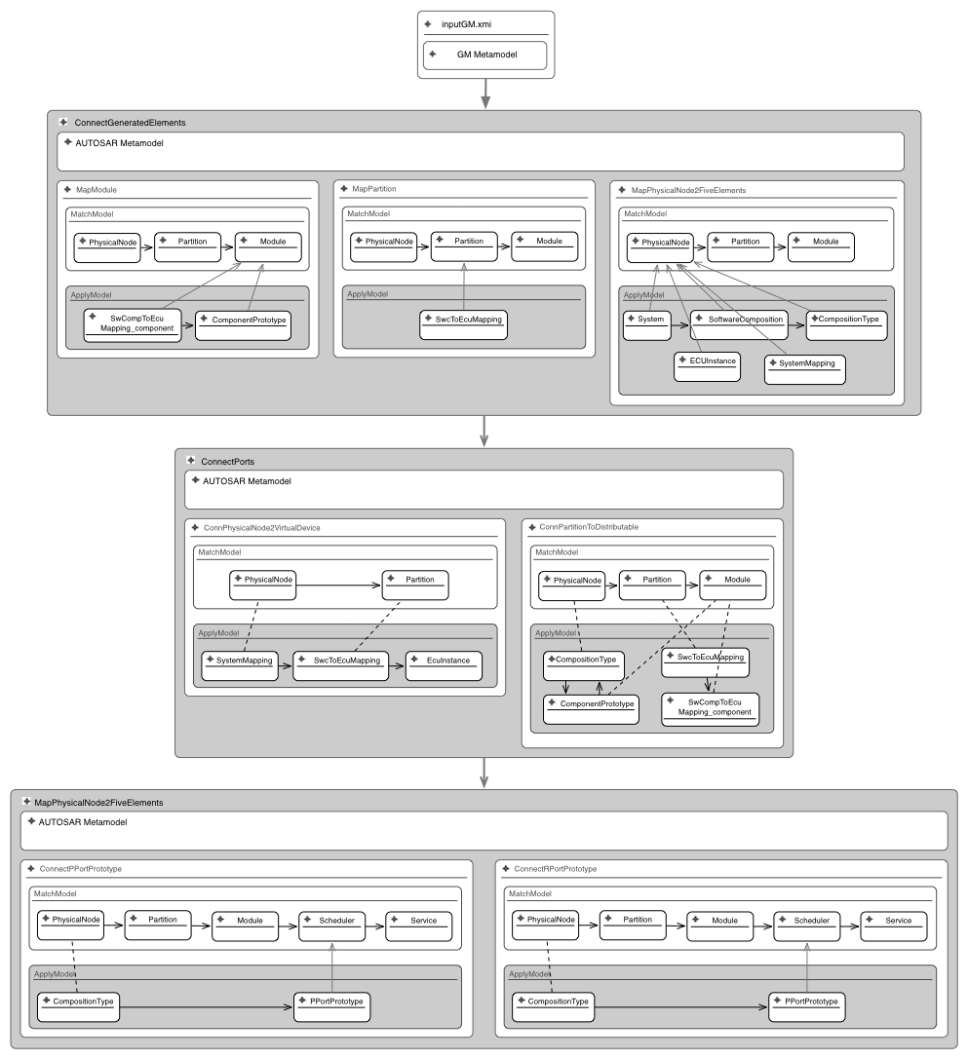

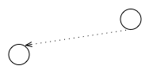
Path Condition Generation of DSLTrans Model Transformations [5,6]
Process
Layer 1
1₁
2₁
3₁
Process
Layer 2
…
…
Process
Layer 3
Unfeasible
Control Path
1₂
2₂
Path Conditions
2₃
2₃
[5] L. Lúcio, B. Barroca, V. Amaral “A Technique for the Verification of Model Transformations” Proceedings of MoDELS, 2010.
[6] A Technique for Symbolically Verifying Properties of Graph-Based
Model Transformations, L. Lúcio, B. Oakes and H. Vangheluwe.
Technical Report SOCS-TR-2014.1, McGill University, 2014.
Notes:
Mention why certain control paths are infeasible
Backward links do not exist the the path conditions built so far
Very abstract view, see my poster for the details of the symbolic execution

Slide 11
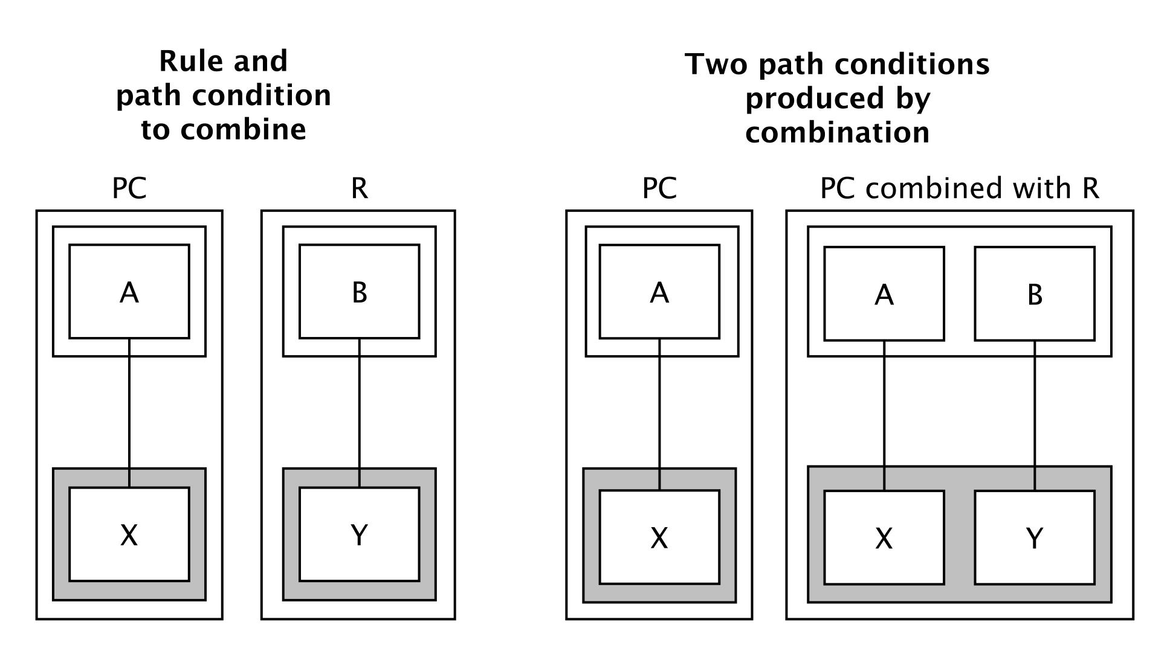
Case 1: Rule has no Dependencies

Slide 12
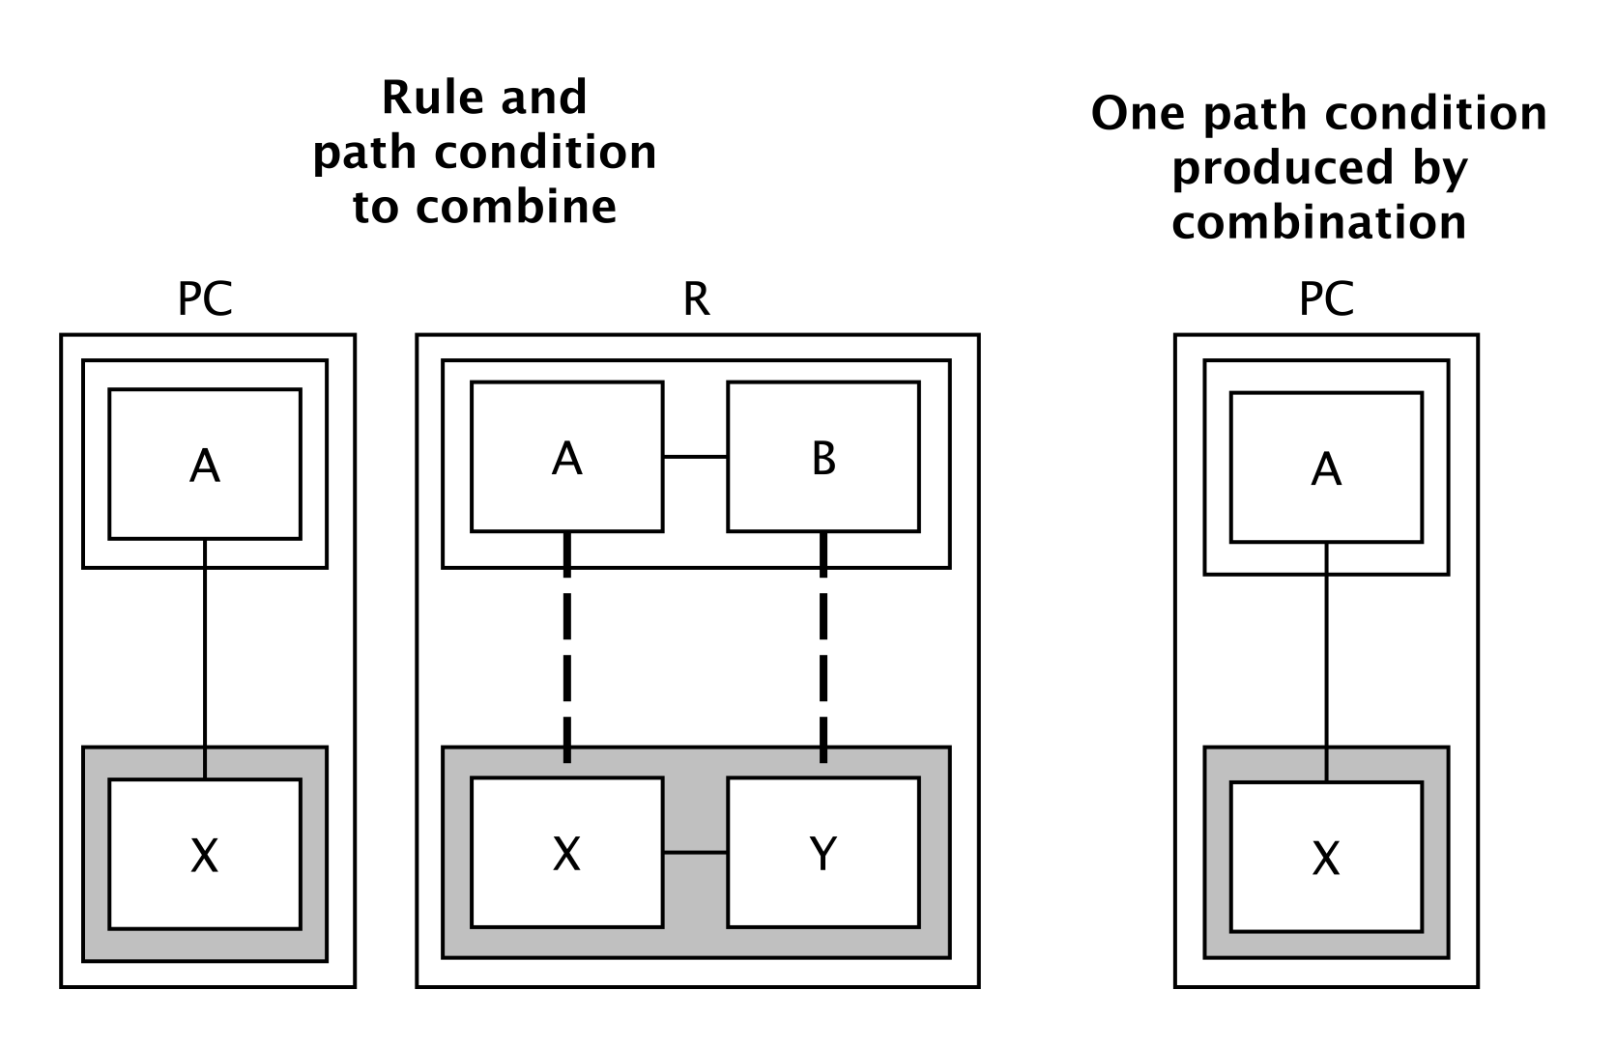
Case 2: Rule’s Dependencies are not Satisfied by the Path Condition

Slide 13
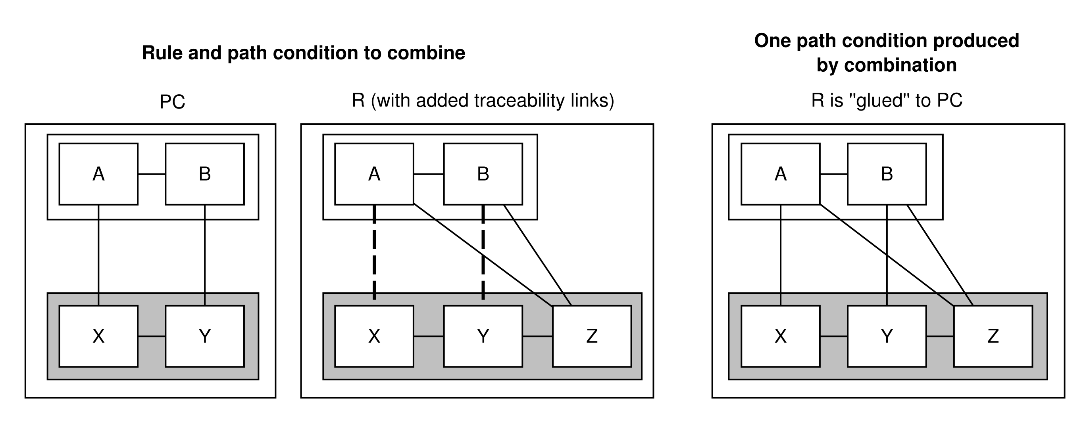
Case 3: Totally- and Partially- Satisfied Dependencies

Slide 14
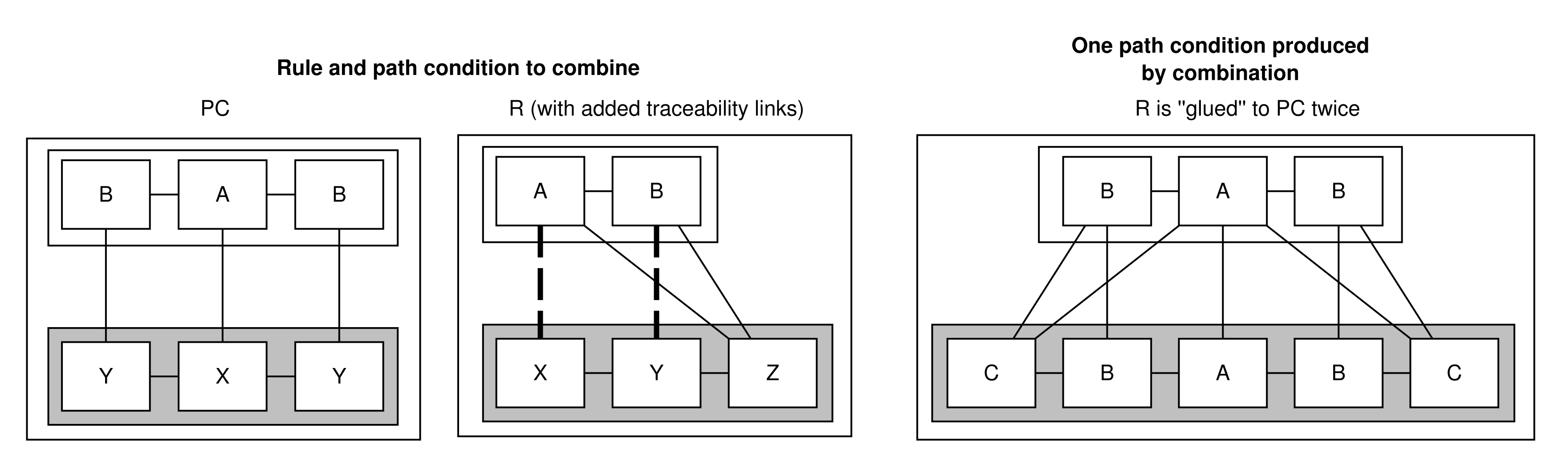
Case 3: Totally- and Partially- Satisfied Dependencies

Slide 15
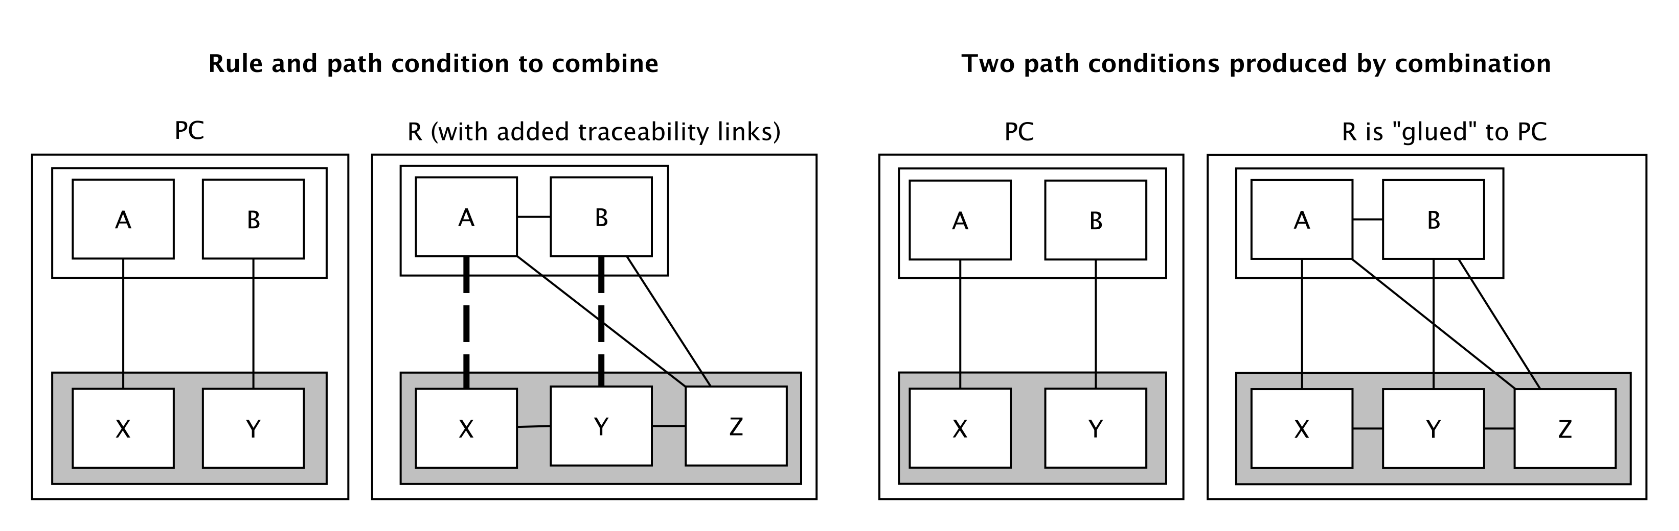
Case 3: Totally- and Partially- Satisfied Dependencies

Slide 16
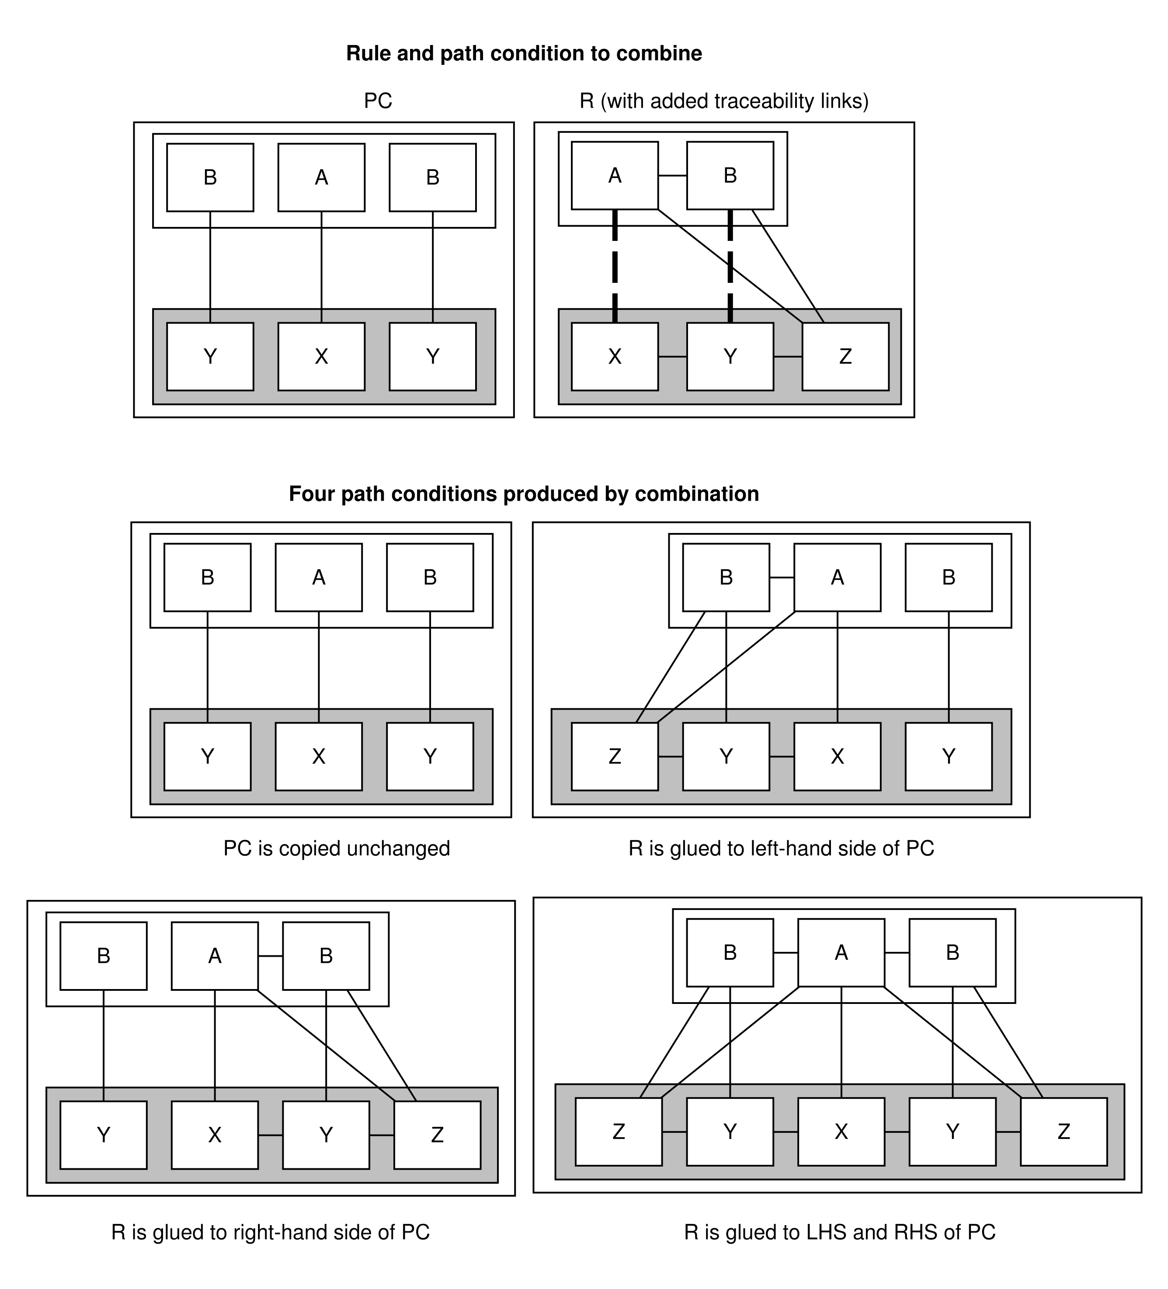

Slide 17
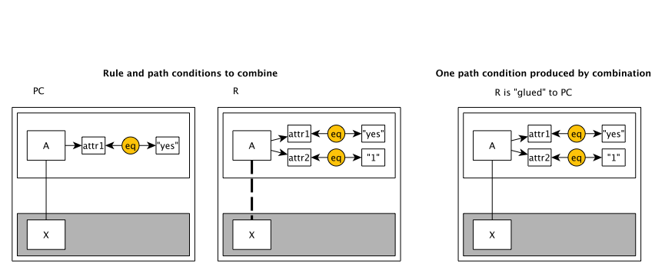
Symbolic Execution of Rules with Conditions on Attributes
Symbolic conditions on attributes are equations on string values and are represented as graphs
Equations are solved using a purposely-built Python String constraint solver

Slide 18
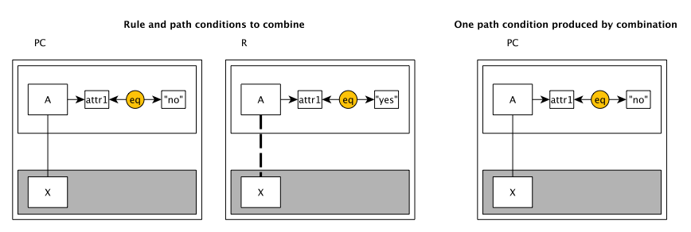
Symbolic Execution of Rules with Conditions on Attributes

Slide 19
Proving Properties
A property is does not hold for a path condition pc whenever its pre-condition is isomorphically found on pc, but its post-condition is not. Otherwise we say the property holds for pc.
A property is holds for a transformation whenever it holds for all of the transformation’s path conditions.

Slide 20
Properties of Property Proving [7]
Validity
Theorem: the result of proving a property for all path conditions generated for a transformation or an all executions of that transformation is the same
Completeness
Theorem: properties of a transformation can be shown to either hold for all transformation executions, or not hold for at least one transformation execution
[7] L. Lúcio, B. Oakes, H. Vangheluwe “A Technique for Symbolically Verifying Properties of Graph-Based Model Transformations”. Technical Report SOCS-TR-2014.1, McGill University, 2014.
Notes:
Talk about abstraction relation here

Slide 21

Implementation
Principle:
Development of the tool should be model-driven (as much as as possible)
“Eat your own dog food!”
First class citizens:
Metamodels
Models
(Higher-Order) Model Transformations

Slide 22



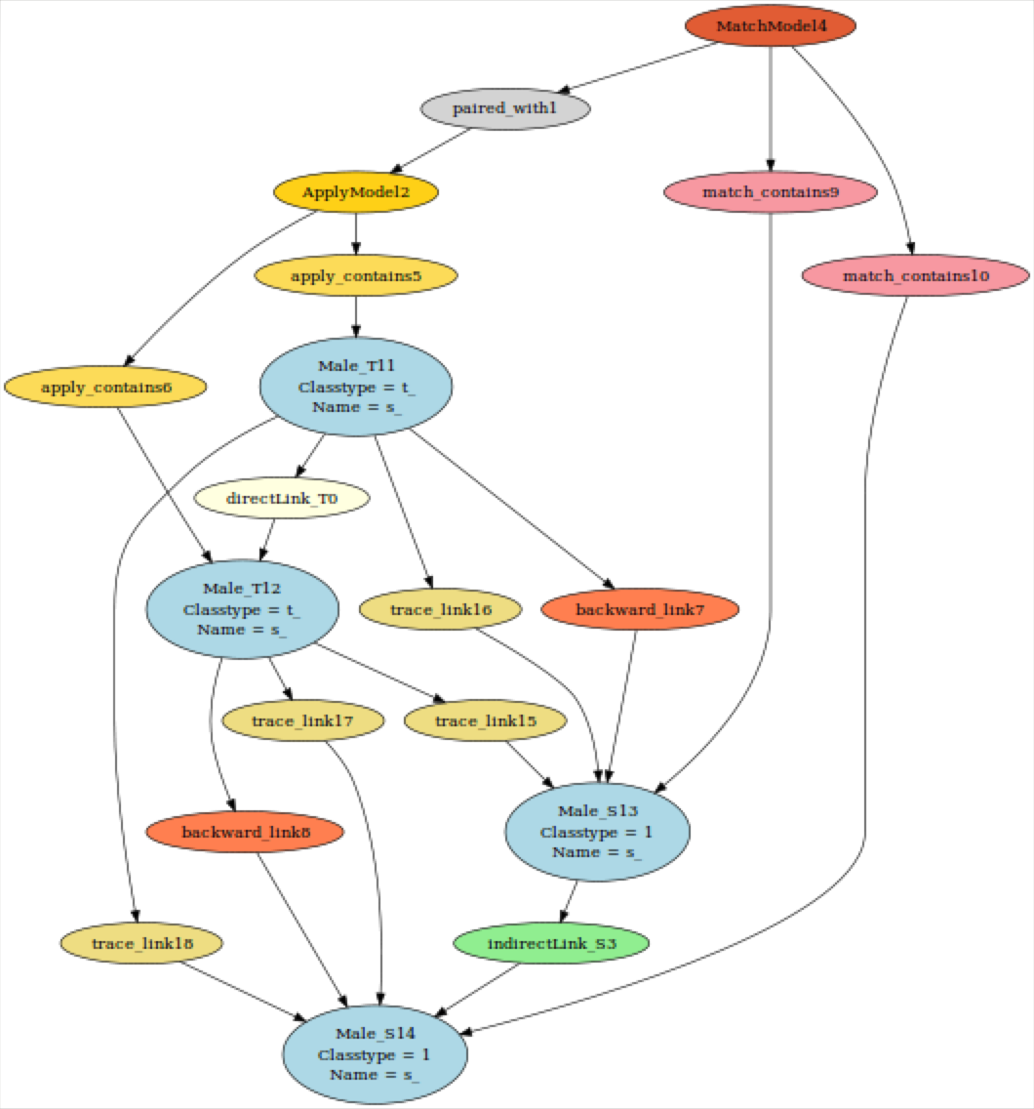
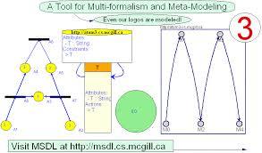







Tooling and developers
T-Core
igraph / Himesis
Levi Lúcio
McGill U.
Bentley Oakes
McGill U.
Gehan Selim
Queen’s U.
Cláudio Gomes
Antwerp U.

Slide 23
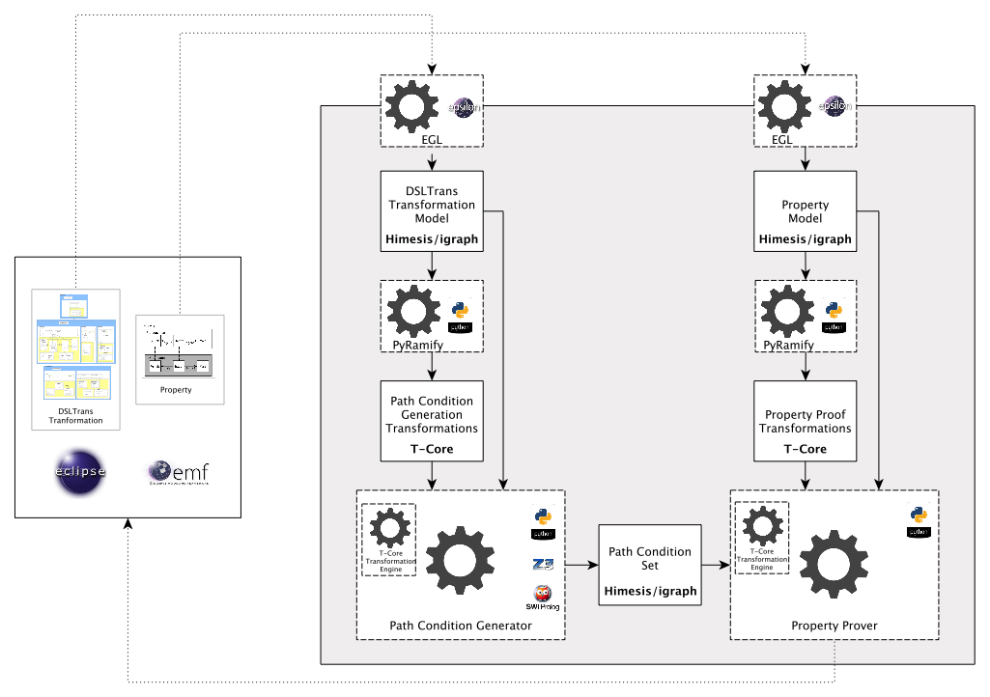
Tool Architecture

Slide 24
Model-Driven Development: Challenges
Challenges
Insufficient higher-order model transformation technology (AToM3) models are not built for memory-intensive applications Transformations and code have to be developed together in an interleaved fashion

Slide 25
Model-Driven Development: Advantages
Advantages
(Surprisingly) speed! Adapted to the domain Models simplify the usage of complex data types

Slide 26
Model-Driven Development: Ambivalent
Ambivalent
Right level of abstraction through the usage of metamodels and model transformations Visual edition and debugging of metamodels, models and model transformations

Slide 27
Case Studies
Case study 1: GM To Autosar
Partial migration transformation from the proprietary VCS architecture language for automotive hardware and software deployment into AUTOSAR.
Small subset of the complete metamodel, for experimentation.
Case study 2: UML-RT To Kiltera (Gehan Selim’s PhD)
Give semantics to UML-RT in terms of the CSP-like language Kiltera, for simulation.
Functional half the UML-RT metamodel is transformed.
Case study 3: mbeddr to C
Give semantics to specifications in the mbeddr language as C code, for execution.
Complete subset of the mbeddr metamodel required for the transformation of connectors between mbeddr components into C function calls.
To prove the property: “for every invocation of a function on an instance of a component by an instance of a another component, via a connector, the correct C function generated by the transformation is called”.

Slide 28
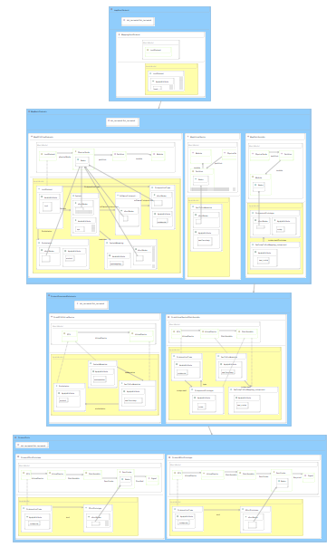
Case study 1: GM To Autosar
Number of rules: 8
Number of layers: 4
Symbolic execution time: 0.6 s
Number of path conditions: 3
Property proving times: 0.02 s on average

Slide 29
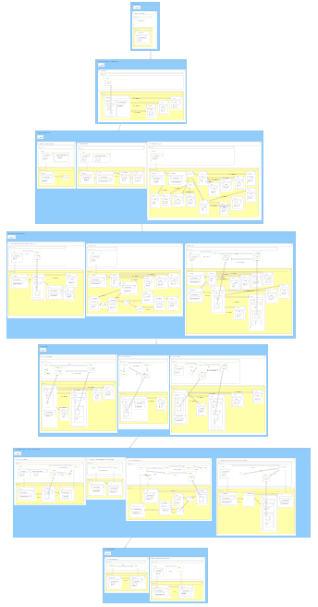
Case study 2: UML-RT to Kiltera
Number of rules: 17
Number of layers: 7
Symbolic execution time: 80 s
Number of path conditions: 330
Property proving times: tens of seconds
Required implementation of the symbolic execution
of conditions on object attributes!

Slide 30
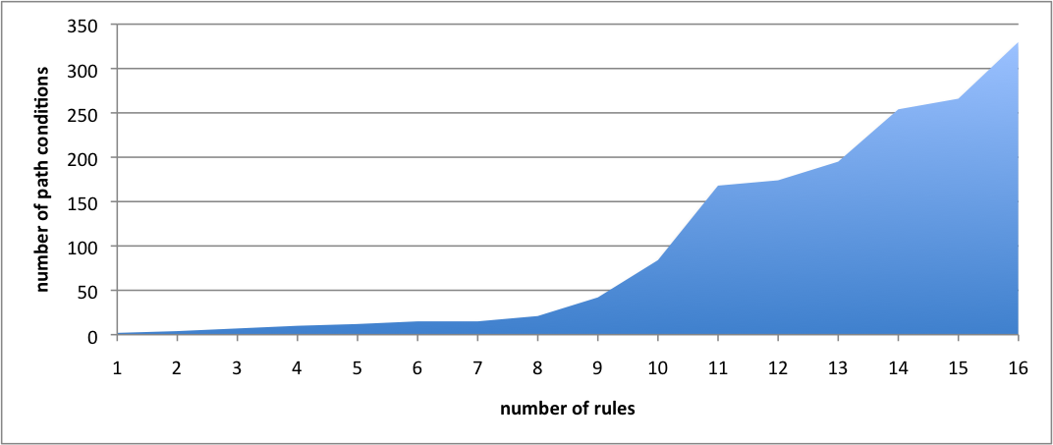
UML-RT to Kiltera: rules vs path conditions

Slide 31
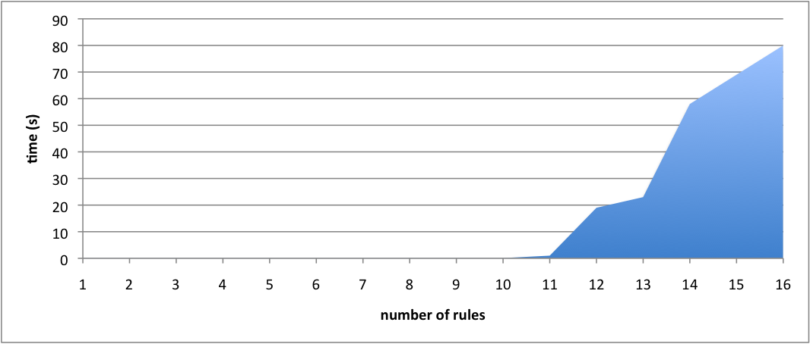
UML-RT to Kiltera: rules vs time

Slide 32
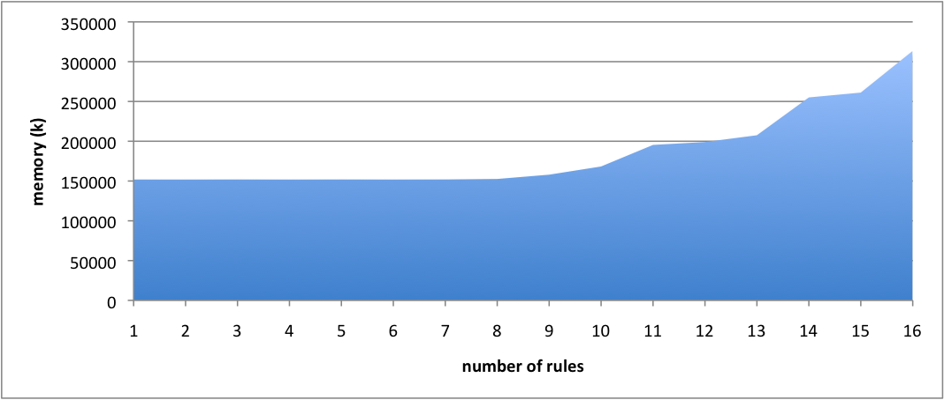
UML-RT to Kiltera: rules vs space

Slide 33
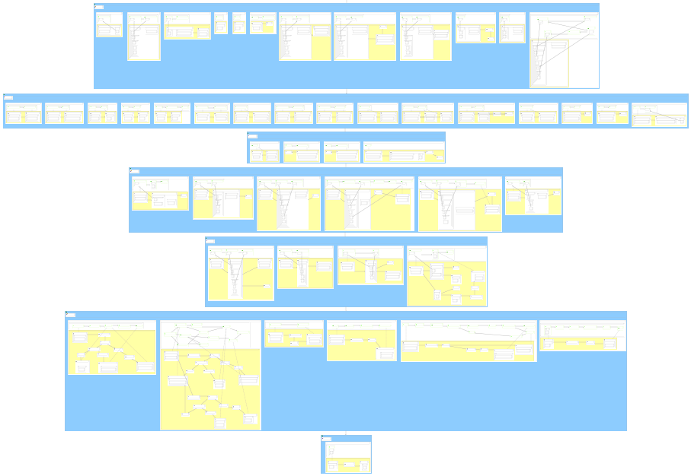
Case study 3: mbeddr to C
Number of rules: 49
Number of layers: 7
Symbolic execution time: 1264 s (23 rules)
Number of path conditions: ?
Property proving times: ?

Slide 34
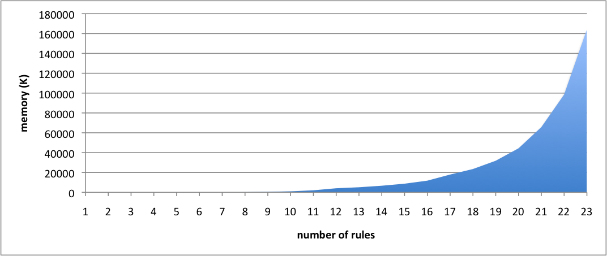
mbeddr to C: rules vs path conditions
number of path conditions

Slide 35
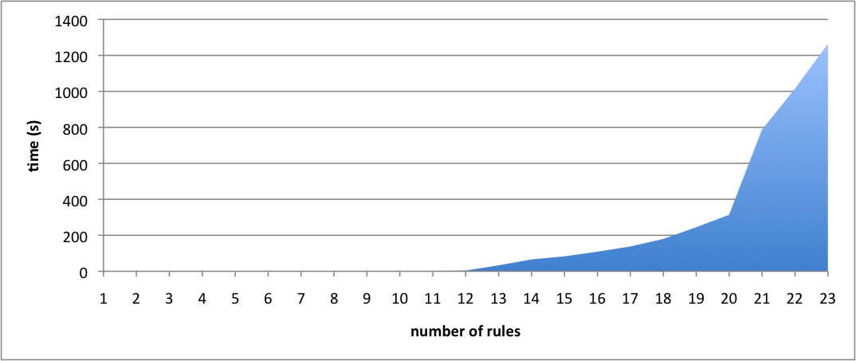
mbeddr to C: rules vs time

Slide 36
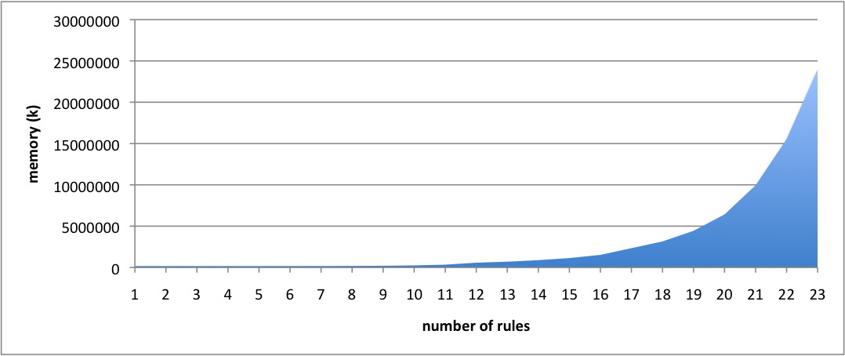
mbeddr to C: rules vs space

Slide 37
Going Mainstream: Proving Properties of ATL Transformations [9]
Transforming ATL transformation into DSLTrans
Properties of ATL transformations
DSLTrans transformation slicing
Results
[9] B. Oakes, J. Troya, L. Lúcio, M. Wimmer. “Fully Verifying Transformation Contracts for Declarative ATL”.
Submitted to MoDELS 2015

Slide 38
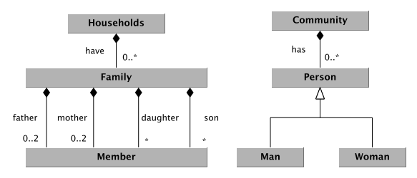
Transforming ATL into DSLTrans

Slide 39
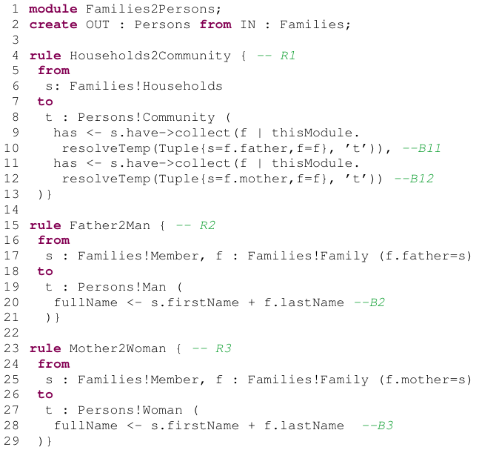
Transforming ATL into DSLTrans

Slide 40
Transforming ATL into DSLTrans

Slide 41
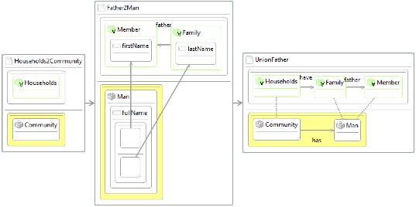
Transforming ATL into DSLTrans
R1

Slide 42
Transforming ATL into DSLTrans

Slide 43
Transforming ATL into DSLTrans
R2
B2

Slide 44
Transforming ATL into DSLTrans

Slide 45
Transforming ATL into DSLTrans
B11

Slide 46
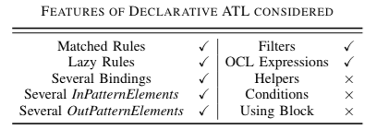
Treated ATL Subset (declarative)

Slide 47
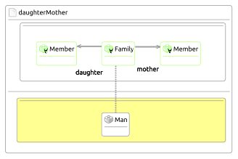
Properties of ATL Transformations
‘A family with a mother and a daughter will always produce a community with a man.’

Slide 48
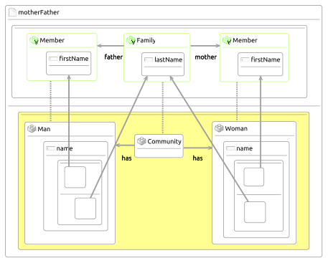
Properties of ATL Transformations
‘The produced Person has been correctly created from the last name of the Family and
the first name of the Member.‘

Slide 49
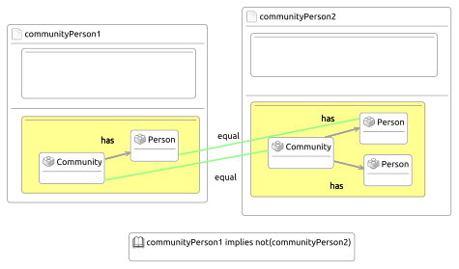
Properties of ATL Transformations
‘A Community is connected to one and only one Person element’.

Slide 50
DSLTrans Transformation Slicing
Select only rules from a DSLTrans transformation which contribute to the proof of a property
Very conservative rule selection algorithm:
rules containing input elements
rules containing output elements
rules containing dependencies for rules where input or output elements occur
Extremely effective for not-too-large properties
Tradeoff between verification time and property size (for example, does not work for the mbeddr transformation)

Slide 51
Results
Transformation | ATL / DSLTrans rules | Path Conds. Gen. | Time (s) | Properties Proved | Time (s) | Memory (MB)
Families-to-Person | 5 / 9 | 52 | 1.54 | 4 | 31.45 | 45
ER-Copier | 5 / 9 | 70 | 0.48 | 1 | 1.70 | 43
Ecore-Copier | 11 / 24 | 57890 | 2894.44 | 1 | 1401.45 | 7800
Sliced Ecore-copier (prop with 2 input types, 2 output types) | 15 / 63 > 13 | 73 | 3.50 | 1 | 9.11 | 72
Sliced Ecore-copier (prop with 2 input types, 2 output types) | 15 / 63 > 17 | 28 | 0.95 | 1 | 0.46 | 71
GM to Autosar | 5 / 9 | 3 | 0.17 | 9 | 0.26 | 48

Slide 52
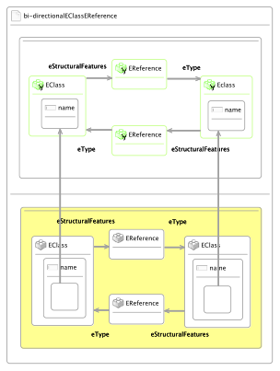
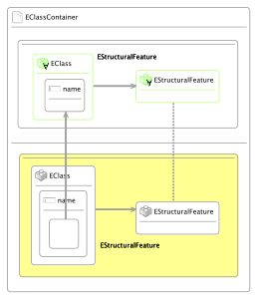
Properties used to Slice the Ecore-Copier
“All bi-directional associations (represented by two inverse EReferences instances)
between EClass instances should have the same end points, i.e., the EClass
Instances should have the same names.”
“If there is an EStructuralFeature instance in the target model, it must have the
equivalent EClass instance as a container as the corresponding source model
EStructuralFeature instance has in the source model.”

Slide 53
Conclusion
We built a theoretically sound property prover for model for syntactic pre- / post-condition contracts
Based on a transformation language of reduced expressiveness
We experimentally validated that technique is applicable to a large class of out-place transformations
Experiments indicate the technique scales well
We validated that properties are expressive and intuitive to use
We have evidence that properties about the preservation of the semantics of transformed models can also be proved
Can be used for other model transformation languages than DSLTrans as demonstrated by the easy “port” into ATL

Slide 54
Future Work
Tool
Finish Eclipse integration with DSLTrans and ATL editors (work with Manuel Wimmer, T.U. Wien)
More experimentation with slicing
Performance improvements (parallelization)
Theory
Right abstraction level to explain soundness and completeness (work with Bernhard Schaetz, fortiss)
Including NACs in the theory of path condition construction

